Slide 1
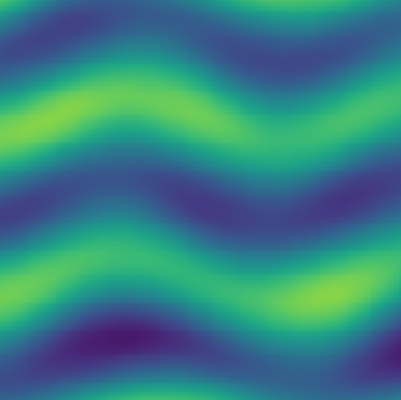



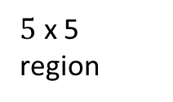



Input (50 x 50 patches)
$5$ x 5 region
relu
relu
relu
$50 x$ 50
$50 x$ 50
$50 x$ 50
$t$+1
$$t$$
$$t−4$$

